Slide 1

Crime Analysis Dashboard
Rahul Menaria 200563265
Rahul Menaria 200555789
Manya 200584753
Vaibhav Patel 200592458

Slide 2
Table of contents
Research Questions
Project Summary
Languages and Tools
Database
Fit Gap Analysis

Slide 3
Project requirements
A company XYZ is looking for a dashboard where they want to analyse the trends in intentional homicide and violent crime rates, providing valuable insights for policymakers, researchers, and the public. Our team got the skill set and what it takes to deliver the solution. Our team is well-equipped to effectively carry out the data collection, storage, and presentation tasks outlined in the project requirements, thanks to our unique blend of analytical skills and technological expertise.
Objective - Build a web application that can show real-time latest crime data that has been retrieved from wikipedia. Make sure that a scheduled batch task updates the database with the most recent information every 24 hours.

Slide 4
Project summary
Fetch
Fetch real-time crime data.
Store
Store data in cloud firebase database.
Display
Display data on web application.
Build
Build an API for Data Access.
Conduct
Conduct the Analysis.

Slide 5

Application Description
The Firebase database that powers this web application retrieves crime data from Wikipedia. The application offers a variety of routes and API endpoints for data collection and retrieval, storing the information in the Firebase database. Data is updated every 24 hours through a scheduled batch operation. The application is developed using Jupyter notebook, along with HTML for the frontend. Python libraries are employed to analyze crime trends, offering users an interactive dashboard that helps them study and comprehend crime dynamics.

Slide 6

Research questions
What are the homicide rate trends in different regions and subregions?
What is the crime rate across USA?
What is the distribution of homicide rate across the globe?
What will be trend next year?

Slide 7
Languages and tools
Python
Jupyter notebook
Github
HTML
Firebase
Wikipedia

Slide 8
Steps involved
Step 1: Use the Wikipedia url to get the live data from website.
Step 2: Store the fetched data into the firebase database.
Step 3 : Implement a Batch process in python to update data every 24 hours.
Step 4: Create a flask API to provide endpoints for data access.
Step 5: Collect data from the firebase API and then create a flask application.
Step 6: Visualize the data using python.

Slide 9

Database
We have implemented Firebase as our cloud database solution. This platform provides robust scalability and reliability for our application. Firebase is a NoSQL database that uses a document-based model to store data, allowing for flexibility in handling diverse data structures. It is particularly effective for real-time synchronization and managing unstructured data. For database interaction, we utilized the Firebase SDK, and for data management, we relied on the Firebase Console.

Slide 10
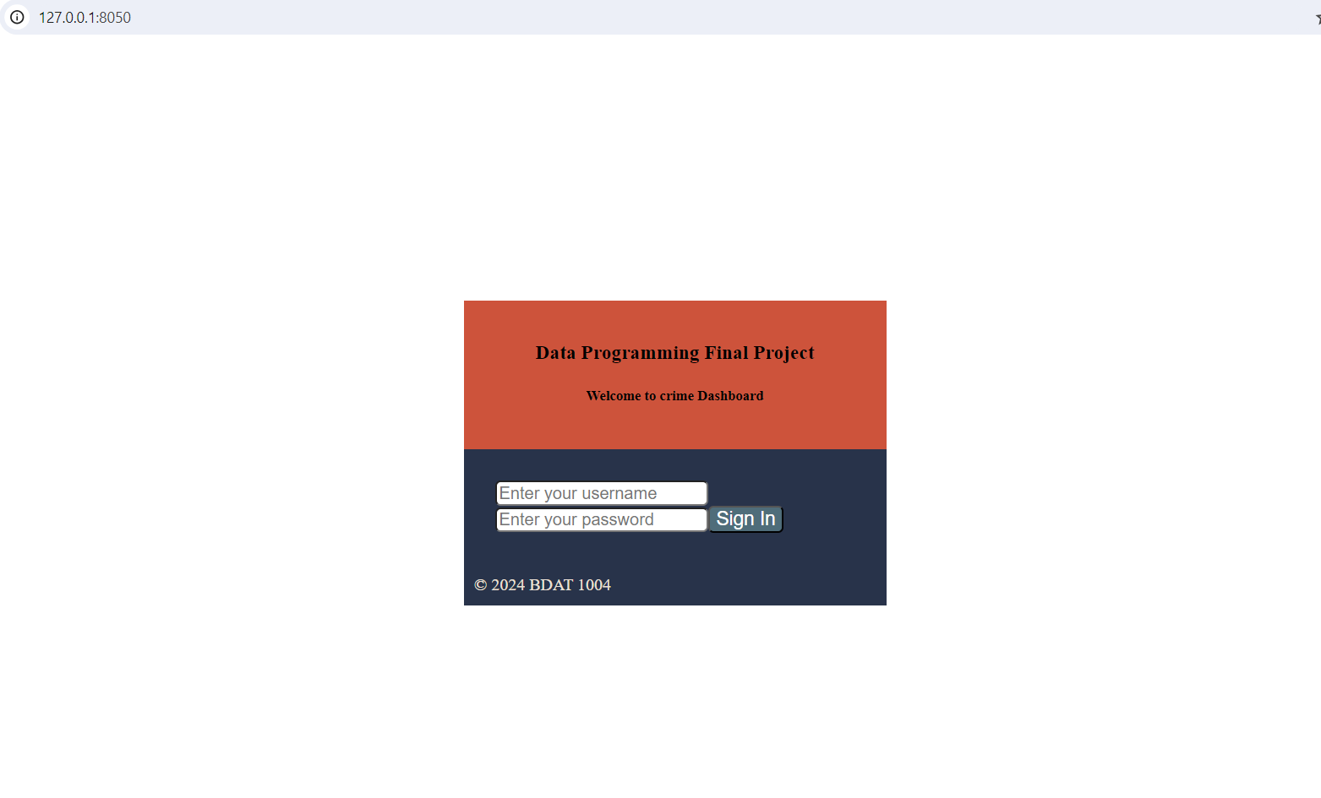
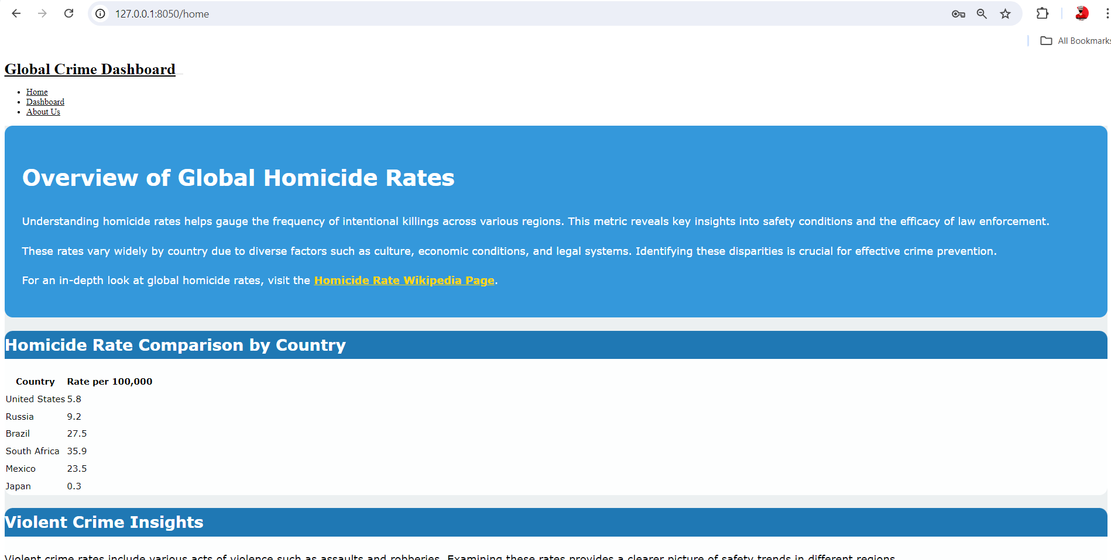
Dashboard login and first page

Slide 11
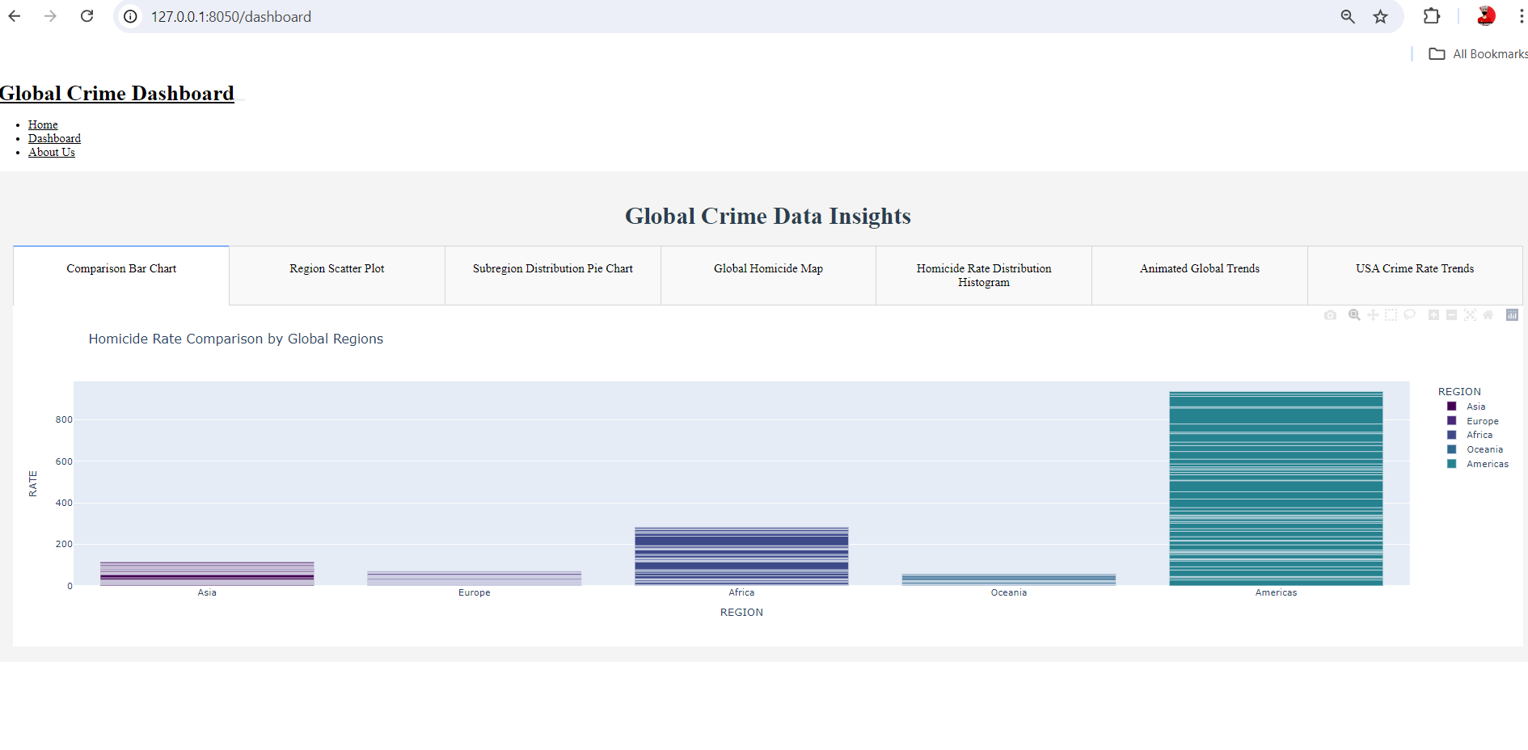
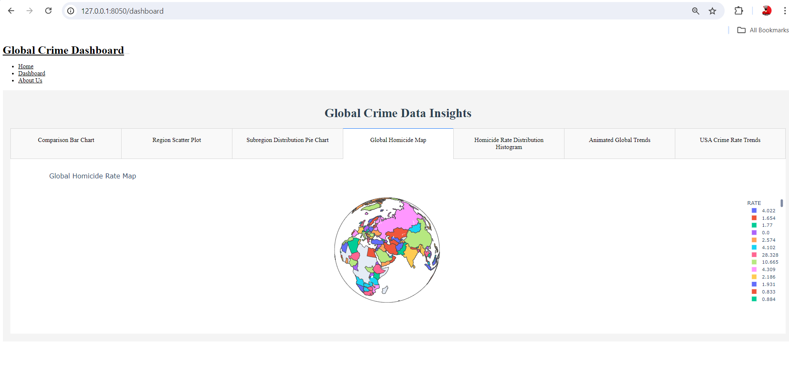
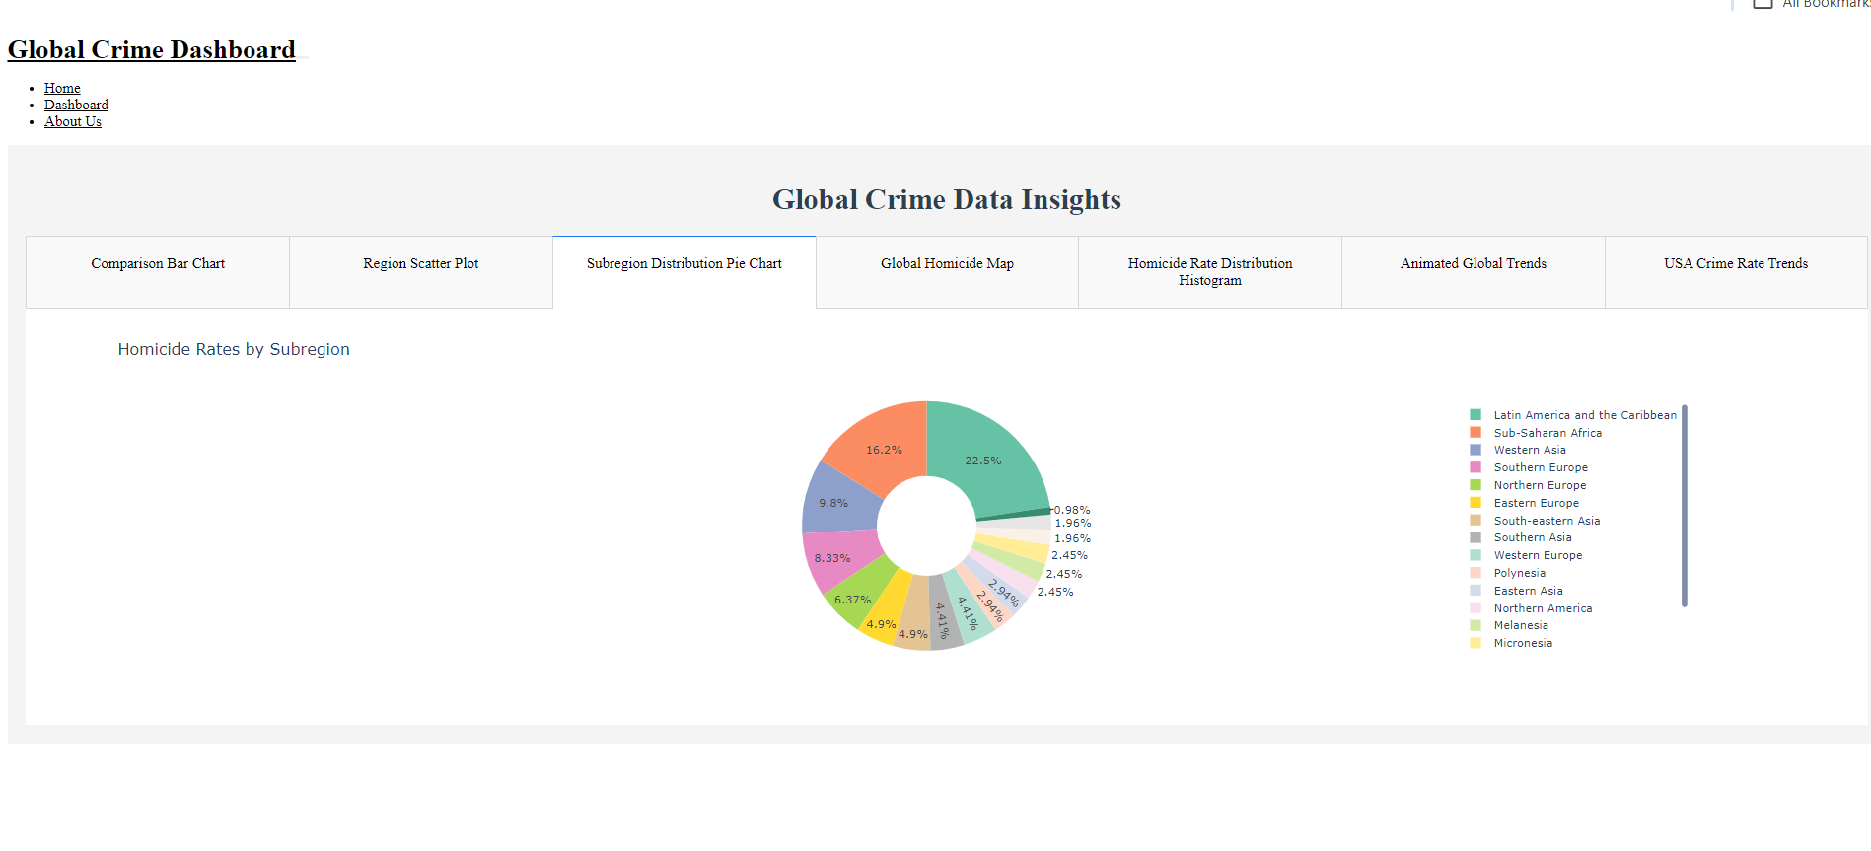
visualizations

Slide 12
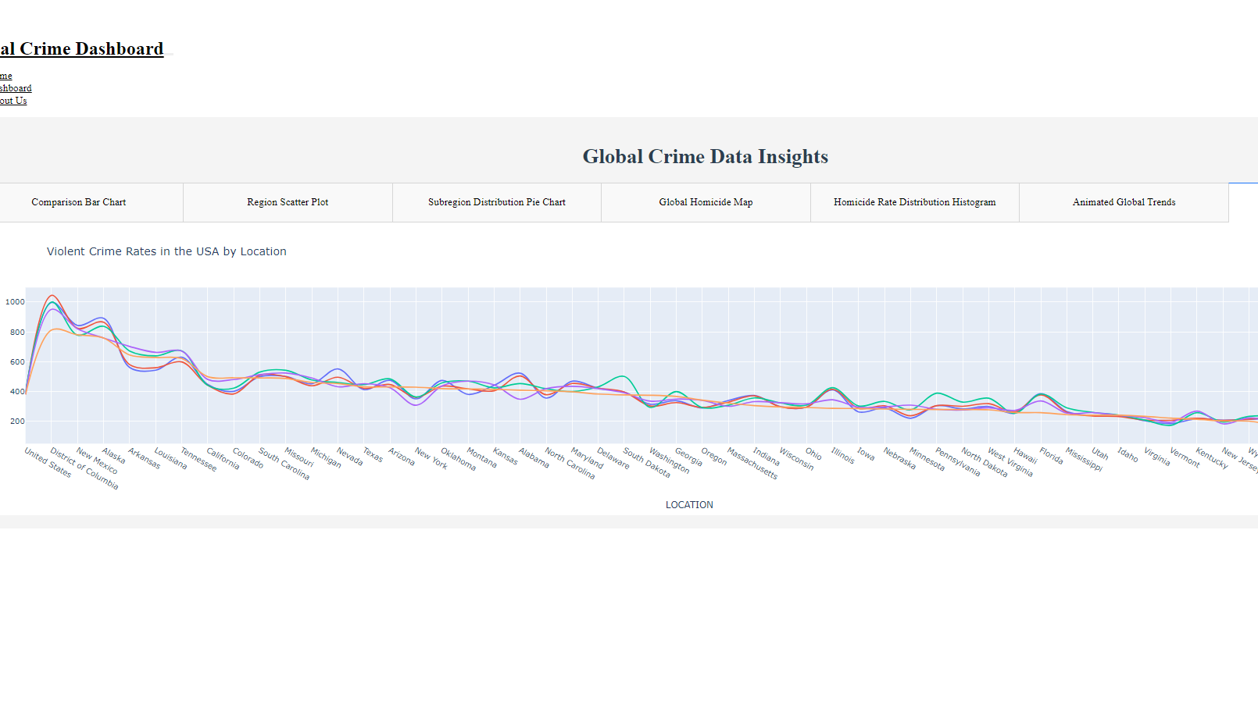
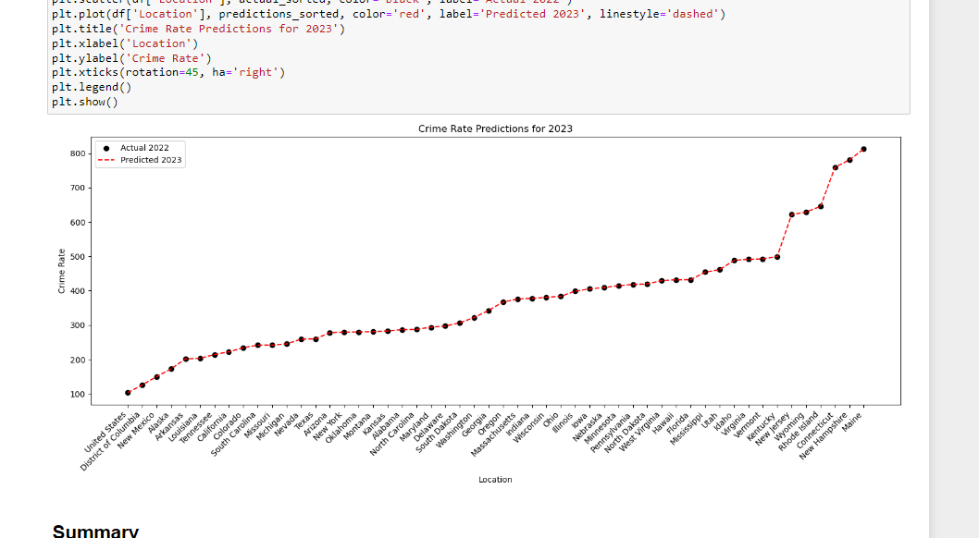
Visualizations contd.

Slide 13
Fit gap analysis
Data Acquisition:
Fit: Successfully implemented data fetching from Wikipedia using Python scripts. The application correctly retrieves and updates crime data every 24 hours, aligning with the requirement for continuous data refresh.
Data Storage:
Fit: Data is stored in Firebase, as specified. The Firebase Firestore structure supports the storage of all necessary crime data, providing efficient real-time data retrieval and management capabilities.
Web Application Development:
Fit: Developed a Flask web application that displays the crime data on a user-friendly interface. Integrated interactive charts and graphs to visualize crime trends and patterns, meeting the project’s visualization requirements.
API Development:
Fit: An API was created with endpoints for accessing crime data. The API allows for fetching all items, filtering by specific criteria, and retrieving data by unique identifiers, fulfilling the project’s API requirements.

Slide 14
Fit gap contd.
Visualization:
Fit: Implemented data visualization using Python libraries, such as Matplotlib and Plotly, along with Google Charts. The visual representations provide clear and interactive insights into crime trends, aligning with the project’s goals.
Deployment:
Fit: The web application is currently deployed on localhost, making it accessible for local development and testing. However, this setup meets the immediate requirement but does not yet allow for external access via a public URL.
Real-Time Updates:
Gap: While data updates every 24 hours, the application could be enhanced to offer real-time updates for more dynamic data monitoring, which would improve user experience and data relevance.
Advanced Filtering and Analysis:
Gap: The current implementation might lack advanced filtering options or analytical tools, limiting user capabilities for in-depth data exploration. This could be an area for future enhancement.
Scalability and Performance Testing:
Gap: Further testing could be performed to ensure that the application scales effectively with increased data load and user traffic. As usage grows, performance optimizations may be necessary to maintain responsiveness.

Slide 15

Thank you

